Slide 1
Atrial Fibrillation Treatment 2011
John Mandrola

Slide 2
Disclosures
None

Slide 3
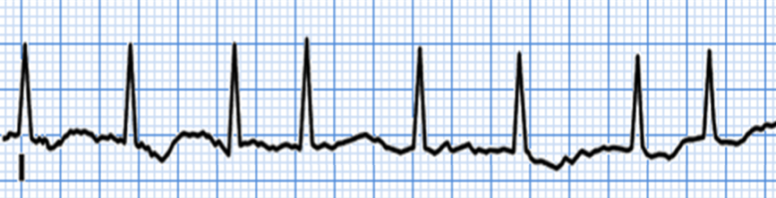
Approach to AF treatment
(after making the diagnosis and exclusion of obvious causes)
Prevent Stroke
Anticoagulants
Devices
Ablation
Treat Symptoms
Rhythm Control
Prevent Heart Failure
Rate Control

Slide 4
Topics for today
An AF doctor’s approach to preventing stroke

Slide 5
What’s the best tool for treating AF?
Drugs?
Devices?
Ablation?
Education
Knowledge

Slide 6
Education
6 Things that I explain
What is AF?
What causes AF?
What our the goals of treatment?
  Cures are rare
What are the possible treatments?
The importance of treating associated conditions
  TLC – Therapeutic Lifestyle Changes
The Quandary…

Slide 7
The Quandary
AF
AF RX

Slide 8
AF Treatment…Bad?
Prolonged QT and VF
  Sotalol, Dofetilide, Amiodarone, dronedarone
1:1 Atrial Flutter and syncope and SCD
  Propafenone, Flecanide
Organ toxicity (Liver, Lung and Thyroid)
  Amio, Dronedarone
Bleeding from blood thinners
Severe Bradycardia warranting an implantable intravascular device
  All AF drugs except dofetilide
Fatigue, exercise Intolerance and shortness of breath
  All AF drugs except dofetilide
Complications from catheter ablation
  Death, Stroke, Pericardial tamponade, Phrenic nerve paralysis, PV stenosis, Pulmonary emboli, pneumonia, vascular complications

Slide 9
Humbling

Slide 10
Stroke in AF
Possible reasons
Loss of mechanical systole
Stasis of blood
Atrial fibrosis
Platelet activation
(E) All of the above

Slide 11
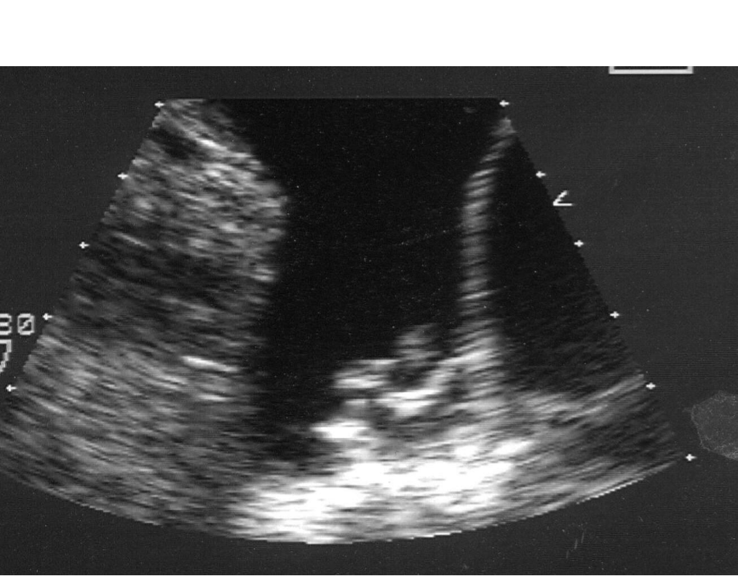
Left Atrial Appendage clot in AF

Slide 12
Plot of 5 Randomized trials of Thrombo-
embolic Prevention with Warfarin
AFSAK
BAATAF
CAFA
SPAF
SPINAF
COMBINED
50% 0% -50%
Coumadin better
than control
Coumadin worse
than control
Risk Reduction

Slide 13
Stroke in AF
Myths
Rhythm-control strategies prevent stroke
Running the INR on the low side (< 2) is an effective strategy for lowering risk of bleeding and still getting some stroke prevention
Intermittent AF confers less stroke risk than permanent AF
Aspirin offers the elderly AF patient a safer and effective strategy of stroke prevention
-BAFTA
-AVEROS
-Danish Registry study (10-11)

Slide 14
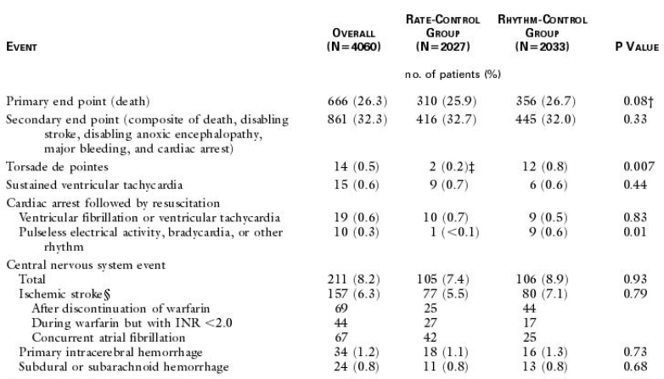
Does rhythm control prevent stroke?
AFFIRM lessons
AFFIRM Trial NEJM 2002

Slide 15
Stroke in AF
Myths
Rhythm-control strategies prevent stroke
Running the INR on the low side (< 2) is an effective strategy for lowering risk of bleeding and still getting some stroke prevention
Intermittent AF confers less stroke risk than permanent AF
Aspirin offers the elderly AF patient a safer and effective strategy of stroke prevention
-BAFTA
-AVEROS
-Danish Registry study (10-11)

Slide 16
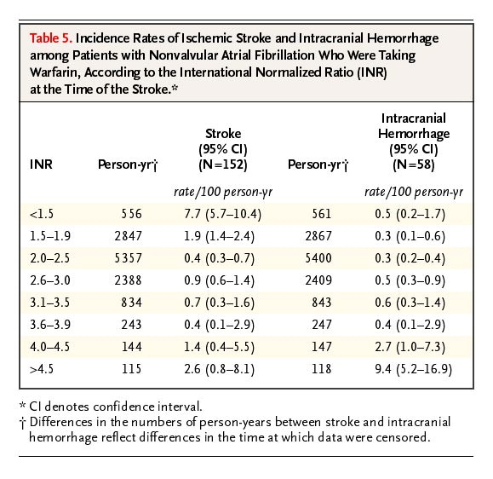

Ischemic Stroke and ICH in AF
13K patients with AF and stroke
  Kaiser Permanente Northern CA
SubRx INR assoc with Inc stroke severity, inc mortality and no fewer ICH
Threshold of Increased ICH
Hylek EM et al. N Engl J Med 2003;349:1019-1026.

Slide 17
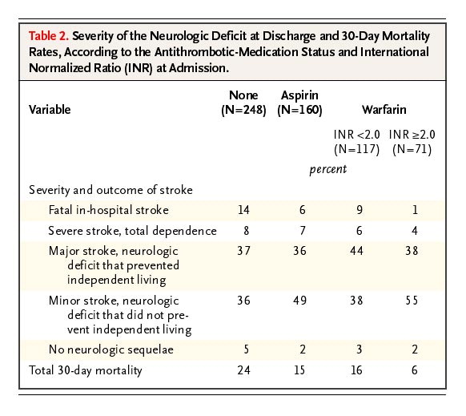
Severity of stroke, according to the intensity of blood-thinner
Adequate blood-thinning assoc with less severe neurologic events
Hylek EM et al. N Engl J Med 2003;349:1019-1026.

Slide 18
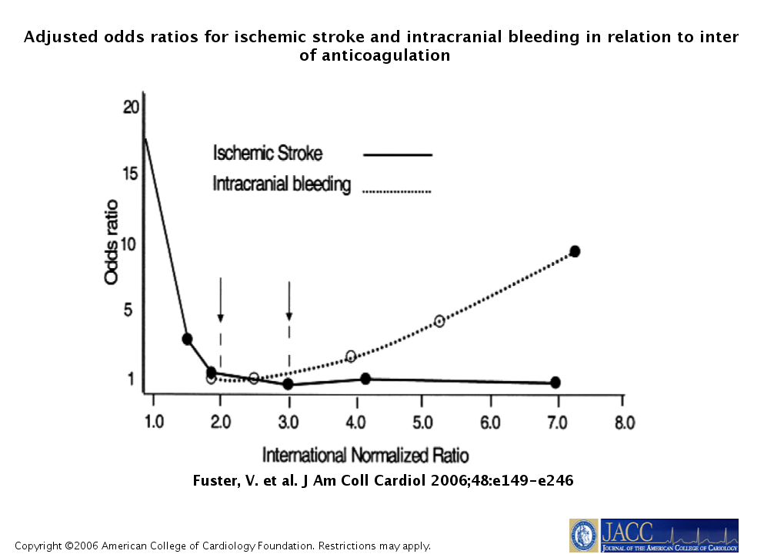


Slide 19
Stroke in AF
Myths
Rhythm-control strategies prevent stroke
Running the INR on the low side (< 2) is an effective strategy for lowering risk of bleeding and still getting some stroke prevention
Intermittent AF confers less stroke risk than permanent AF
Aspirin offers the elderly AF patient a safer and effective strategy of stroke prevention
-BAFTA
-AVEROS
-Danish Registry study (10-11)

Slide 20
Stroke Risk: Intermittent AF versus Persistent/Permanent
European Guidelines
Patients with paroxysmal AF should be regarded as having a stroke risk similar to those with persistent or permanent AF, in the presence of risk factors.

Slide 21
Stroke in AF
Myths
Rhythm-control strategies prevent stroke
Running the INR on the low side (< 2) is an effective strategy for lowering risk of bleeding and still getting some stroke prevention
Intermittent AF confers less stroke risk than permanent AF
Aspirin offers the (elderly) AF patient a safer and equally effective strategy for preventing stroke
-BAFTA
-AVEROS
-Danish Registry study (October 2011)

Slide 22
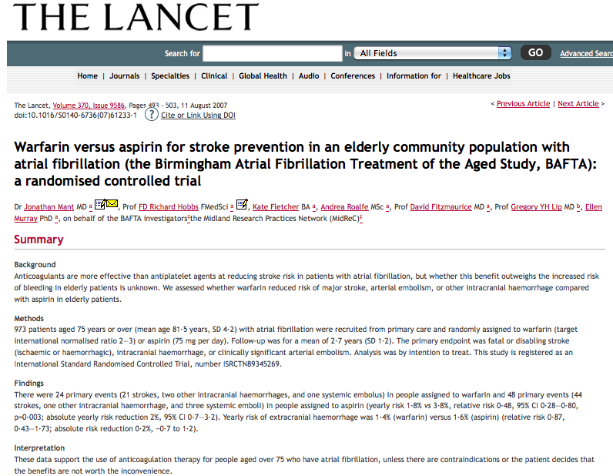
BAFTA Trial (2007)
Real-world cohort of 975 elderly patients (>75 years) w/AF (Private practice)
OAC vs ASA
Far fewer strokes with OAC (RR =52%)
No differences in ICH or bleeding

Slide 23
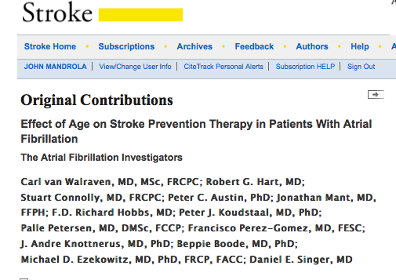
Effect of Age on Stroke Prevention RX in AF
(2009-Stroke)
Meta-Analysis of 8000+ patients from RCT of OAC and ASA
Results:
  Relative benefit of OAC did not vary by age
  Increased bleeding risk with OAC was far smaller than beneficial reduction in stroke
  Relative benefit of ASA decreased with increasing age.
Conclusion:
  Because stroke risk increases with age, the absolute benefit of OAC increases as patients age

Slide 24
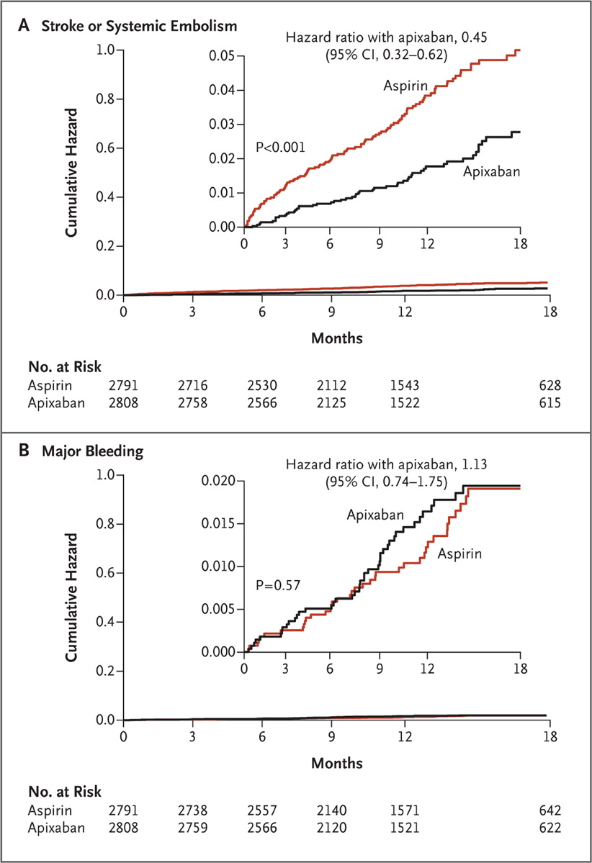
AVEROS Trial (NEJM 2010)
5000+ warfarin-unsuitable AF patients randomized to Apixaban or ASA
Apixaban sig reduced risk of stroke without an increase in bleeding
Connolly SJ et al. N Engl J Med 2011;364:806-817.
Notes:
Figure 1. Cumulative Hazard Rates for the Primary Efficacy and Safety Outcomes, According to Treatment Group. Panel A shows the cumulative hazard rates for the primary efficacy outcome (stroke or systemic embolism), and Panel B the rates for the primary safety outcome (major bleeding) in the apixaban and aspirin groups.

Slide 25
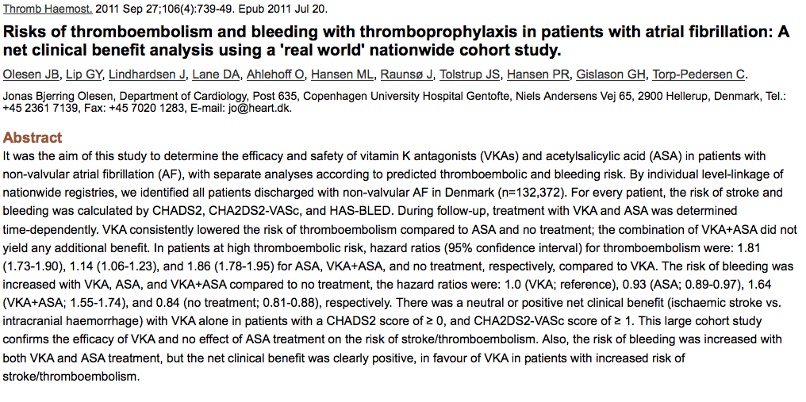
Risks of stroke and bleeding in patients with AF: A net clinical benefit analysis using a 'real world' nationwide cohort study.
(2011)
132,000 Danish AF patients
  F/U 7 days to 12 years
Warfarin alone consistently decreased stroke risk
  Except in very low risk patients (CHADS2 = 0)
ASA ineffective compared to OAC
Bleeding Risk increased with ASA, Warfarin, Combination
  Highest bleeding risk w/combination

Slide 26
Despite all the data…
ASA is still overused;
Anticoagulants underused;
Patients at highest risk not being anti-coagulated;
Females less aggressively treated

Slide 27
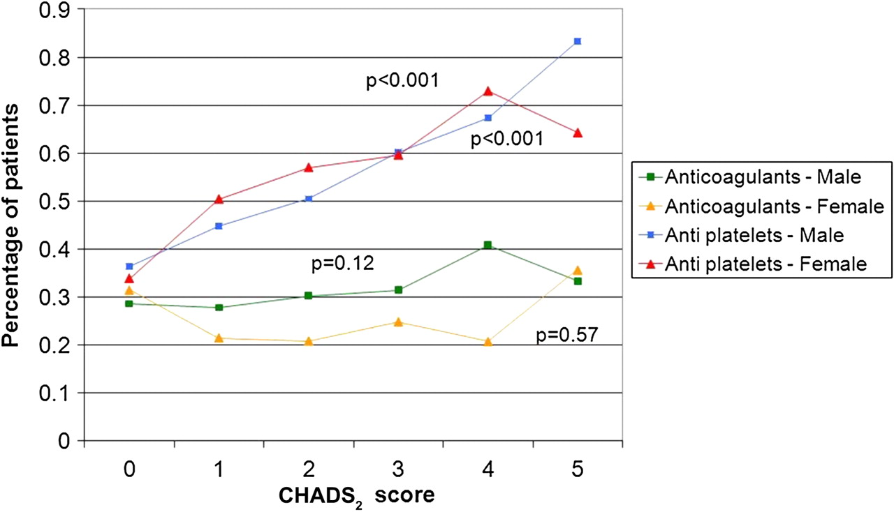

Percentage of AF patients treated with anticoagulant and antiplatelet therapy prior to stroke by CHADS2 score.
32.000 AF patients in UK from 1999-2008
Lee S et al. BMJ Open 2011;1:e000269
©2011 by British Medical Journal Publishing Group
Notes:
Percentage of GP-coded AF patients treated with anticoagulant and antiplatelet therapy prior to stroke by CHADS2 score. AF, atrial fibrillation; GP, general practitioner.

Slide 28
Deciding on anticoagulation…

Slide 29
Stratification of stroke risk in AF
CHADS2
Points
Congestive Failure 1
  (LV dysfunction)
HTN 1
Age > 75 1
Diabetes 1
Stroke (previous stroke /TIA) 2
JAMA 2001

Slide 30
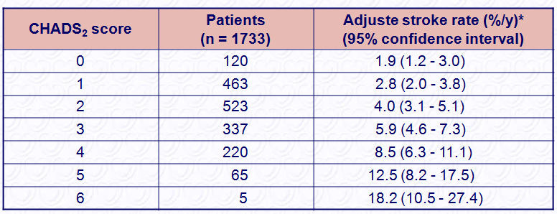
CHADS₂ score and stroke rate
Gage BF, Waterman AD, Shannon W, Boechler M, Rich MW, Radford MJ. Validation of clinical classification schemes for predicting stroke: results from the National Registry of AF JAMA 2001;285:2864 – 2870.
Notes:
30

Slide 31
North American (AHA/ACC/HRS) guidelines for stroke prevention
Nothing or ASA
Anticoag or ASA
Anticoag (INR 2-3)
CHADS2 = 0
CHADS2 = 1
CHADS2 >= 2

Slide 32
Advantages of CHADS2
Simple (That’s always good.)
Concrete
Easy to remember
Validated with a good evidence base

Slide 33
Weakness of CHADS2
Is it too simple?
How low risk is Zero?
Intermediate Risk is broad:
  CHADS2 =1 represents a diverse and large cohort
  Given the North American guidelines for CHADS =1 ASA or Anticoag, CHADS2 leaves the door open for under-treatment with ASA

Slide 34
CHADS2 Cases
CHADS2 = 0 :
  74 year-old female smoker with severe CAD
  34 year old medical student
CHADS2 = 1:
  74 year-old female with severe CAD and diabetes
  34 year-old medical student w/HTN

Slide 35
Can we do better than CHADS2?
CHA₂DS₂-VASc
+ Female Gender
+ Age 65-74
+ Vascular disease
  CAD
  PAD
  Aortic Plaque

Slide 36
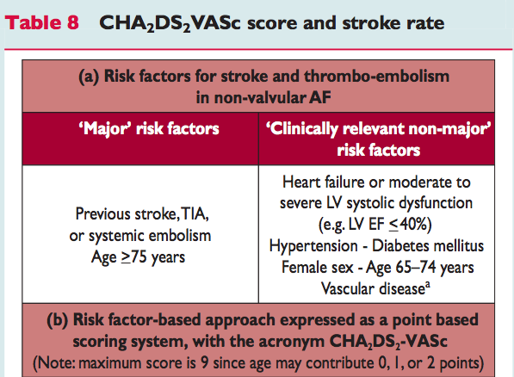

Slide 37
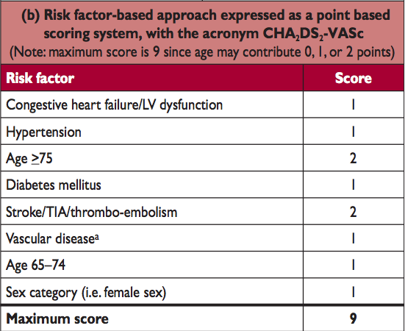

Slide 38
CHADS₂ -> CHA₂DS₂VASc
CHA2DS2-VASc Risk | Score
CHF or LVEF < 40% | 1
Hypertension | 1
Age > 75 | 2
Diabetes | 1
Stroke/TIA/ Thromboembolism | 2
Vascular Disease | 1
Age 65 - 74 | 1
Female | 1
CHADS2 Risk | Score
CHF | 1
Hypertension | 1
Age > 75 | 1
Diabetes | 1
Stroke or TIA | 2
From ESC AF Guidelines
http://www.escardio.org/guidelines-surveys/esc-guidelines/GuidelinesDocuments/guidelines-afib-FT.pdf

Slide 39
CHADS₂ -> CHA₂DS₂VASc
CHA2DS2-VASc score | Patients (n = 7329) | Adjusted stroke rate (%/year)
0 | 1 | 0
1 | 422 | 1.3
2 | 1230 | 2.2
3 | 1730 | 3.2
4 | 1718 | 4.0
5 | 1159 | 6.7
6 | 679 | 9.8
7 | 294 | 9.6
8 | 82 | 6.7
9 | 14 | 15.2
CHADS2 score | Patients (n = 1733) | Adjusted stroke rate %/year
0 | 120 | 1.9
1 | 463 | 2.8
2 | 523 | 4.0
3 | 337 | 5.9
4 | 220 | 8.5
5 | 65 | 12.5
6 | 5 | 18.2
From ESC AF Guidelines: http://www.escardio.org/guidelines-surveys/esc-guidelines/GuidelinesDocuments/guidelines-afib-FT.pdf

Slide 40
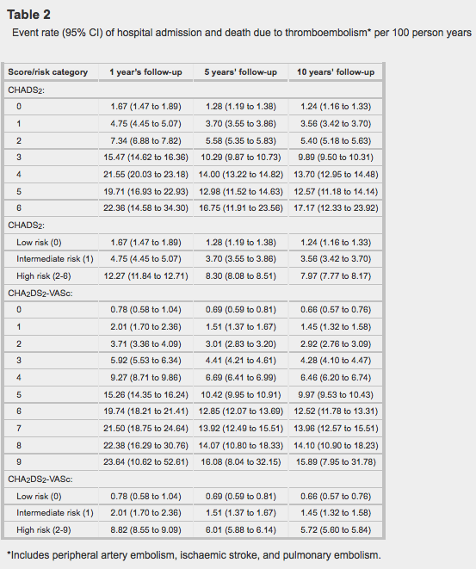
CHADS2 vs CHA2DS2-VASc
73,000 AF patients in Denmark registry, not treated with warfarin and followed clinically from 1997-29006
How did the two validation schemes compare?
BMJ 2011; 342:d124

Slide 41
CHA2DS2-VASc was better:
Low risk is lower
Intermediate
risk more defined
BMJ 2011; 342:d124

Slide 42
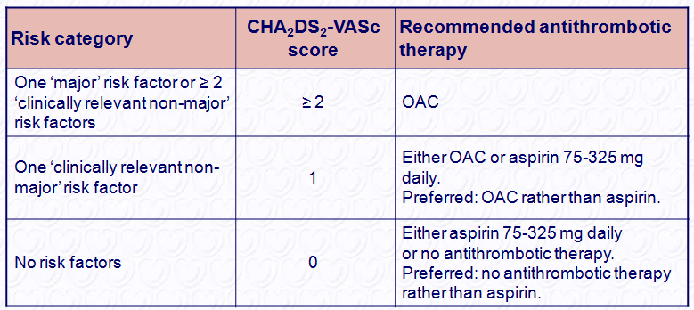
European approach to AF stroke prevention
Notes:
42

Slide 43
Take home advantages of CHA2DS2-VASc
“Euro-CHADS”
Low risk: CHA2DS2-VASc (0) patients at very low risk.
  No anticoag needed
Intermediate Risk:
  With CHADS (1)– 32% patients fall in ASA or Warfarin
  With CHA2DS2-VASc (1)– only 11% fall in ASA or Warfarin group
Euro-CHADs has slightly improved c-statistic

Slide 44
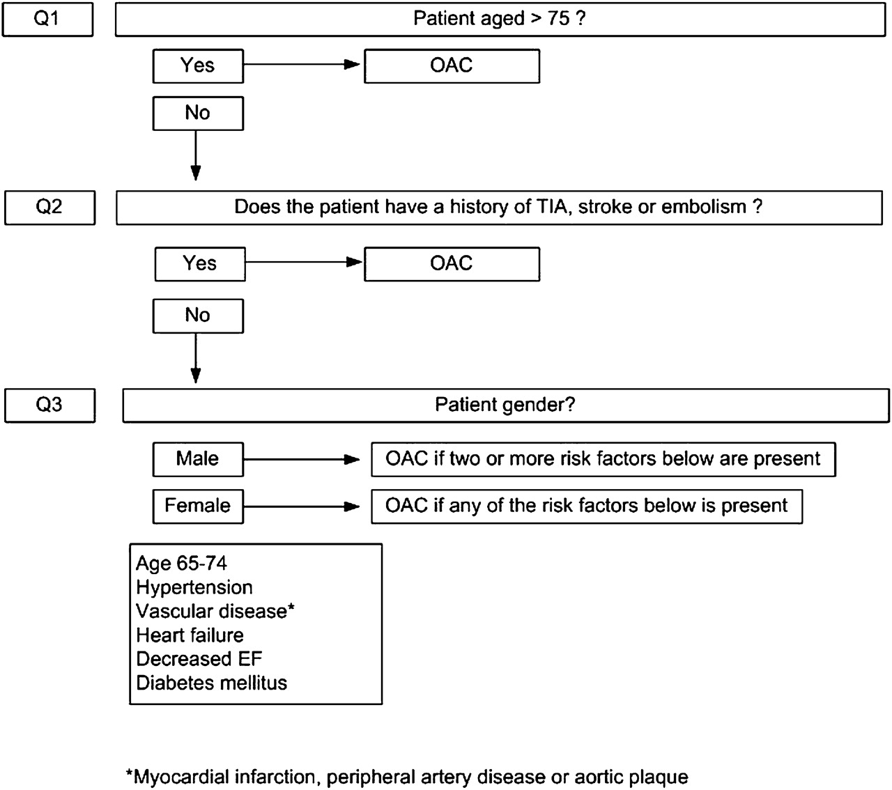

Proposed clinical flowchart for stroke prevention in AF
©2010 by American College of Chest Physicians
Lip G Y H et al. Chest 2010;137:263-272
Notes:
Proposed clinical flowchart for the use of oral anticoagulation for stroke prevention in atrial fibrillation.

Slide 45
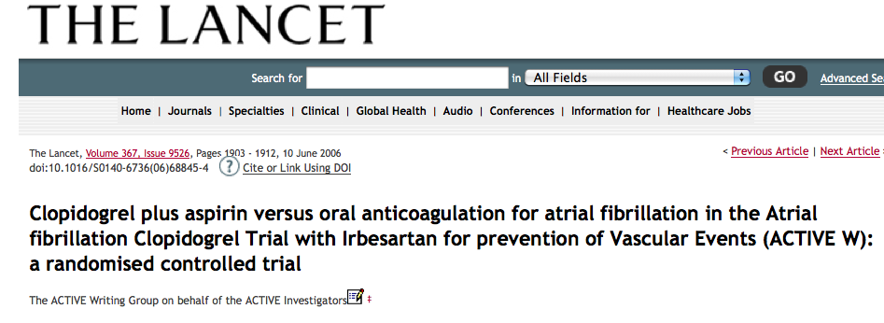
Clopidogrel vs VKA: ACTIVE-W
Clear superiority of warfarin over clopidogrel (40% Risk reduction)
Study stopped prematurely due to warfarin benefit

Slide 46
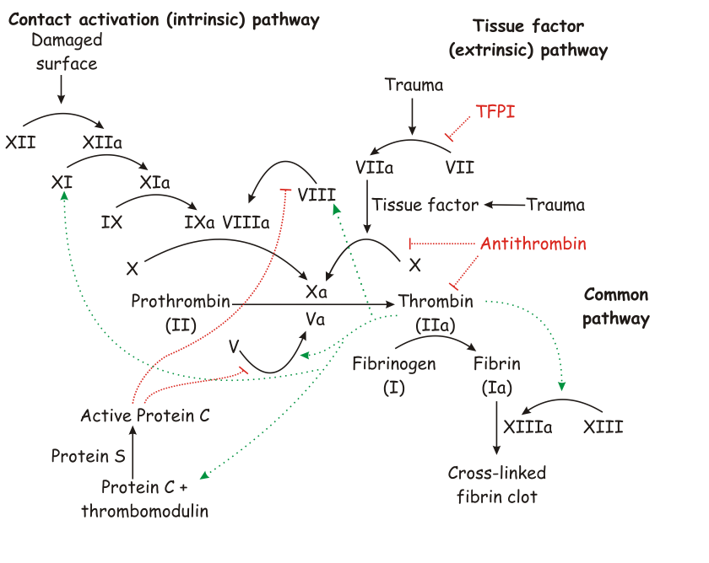
The new oral blood thinners
Factor Xa-Inhibitors
  Rivaroxaban
  Apixaban
Direct Thrombin Inhibitor
  Dabigatran

Slide 47
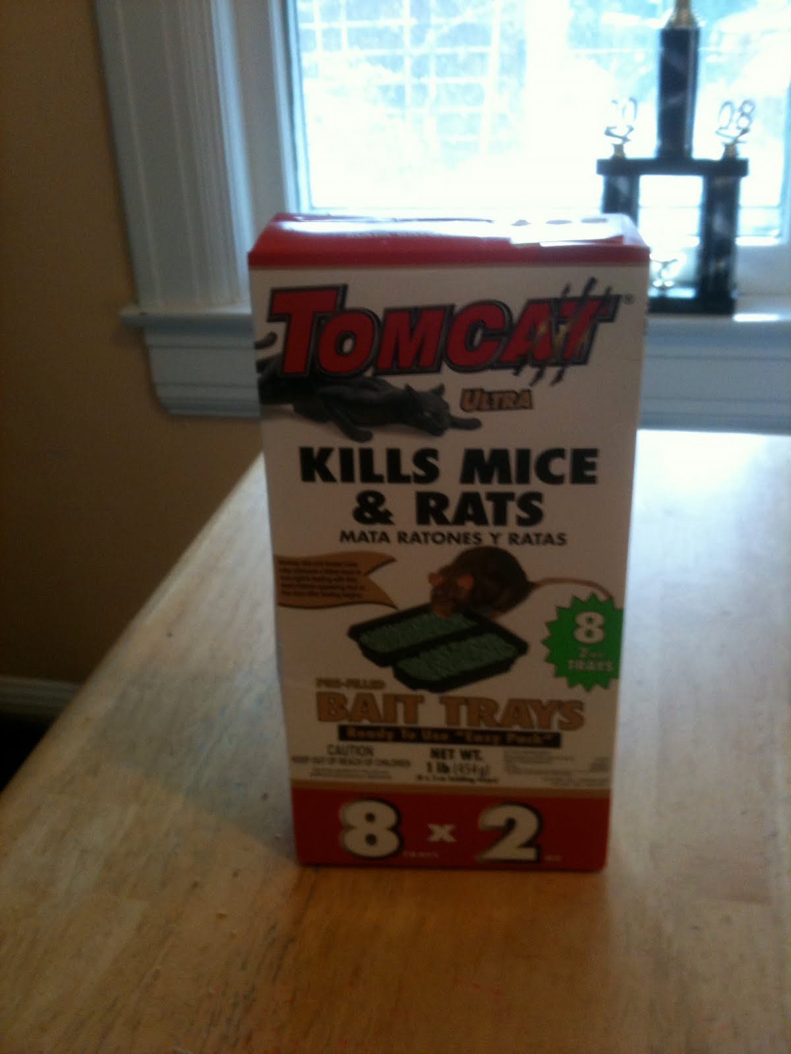
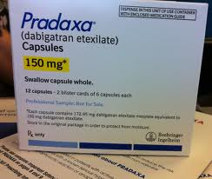
The then and now…

Slide 48
Dabigatran
Data
Clinical caveats
Limitations

Slide 49
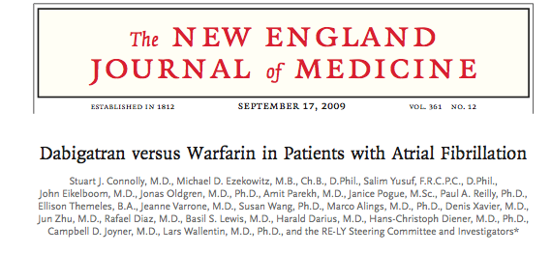
RE-LY Trial
2009

Slide 50
RE-LY
NEJM 2009
Methods:
  18, 000 AF patients randomized to dabigatran 110mg bid, dabigatran 150mg bid or warfarin
Results:
  Average CHADS2 score =2; mean age 71
  Mean f/u 2 years
  Warfarin TTR 64%

Slide 51
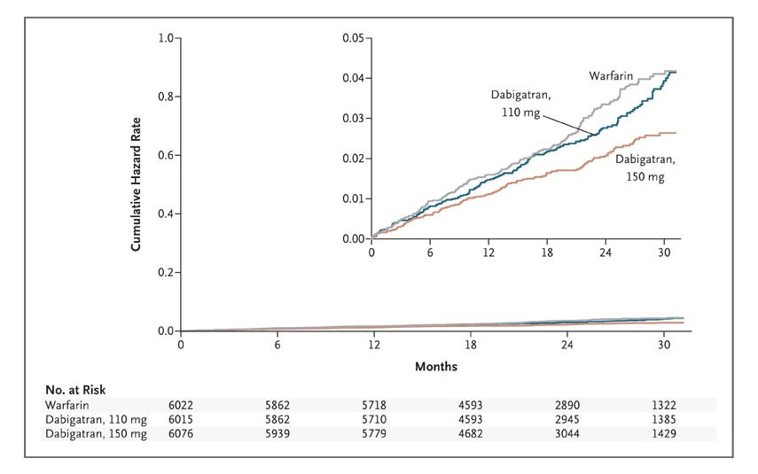
RE-LY: Cumulative Hazard Rates for the Primary Outcome of Stroke or Systemic Embolism
Connolly SJ et al. N Engl J Med 2009;361:1139-1151.
Notes:
Figure 1. Cumulative Hazard Rates for the Primary Outcome of Stroke or Systemic Embolism, According to Treatment Group.

Slide 52
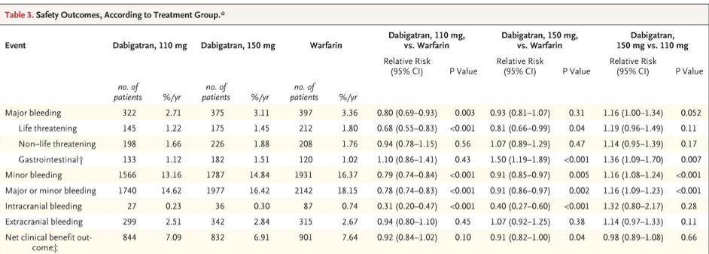
RE-LY: Safety Outcomes

Slide 53
RE-LY Bleeding Data
 | Warfarin (n= 6022) | Dabigatran 150 (n=6076) | P-Value
Major Bleeds | 397 | 375 | p=0.31
Life-threatening bleeds | 212 | 175 | p=0.04
ICH | 87 | 36 | p < 0.001
GI Bleeds** | 129 | 182 | p< 0.001

Slide 54
Dabigatran Facts
Mechanism of Action
  Direct Thrombin inhibitor (Final pathway)
Pharmacology
  Rapid onset of action (1 hour) and half life 12-14 hours
  Cleared primarily through kidneys; dose adjustments required when GFR < 30
  BID dosing
  No significant drug interactions
  No dietary interactions
Adverse Effects
  12% reported “dyspepsia.”
Convenience Factors
  No INR testing

Slide 55
Dabigatran
Positives
Negatives
Superior to warfarin
  Fewer strokes
  Less ICH
  Trend toward lower mortality
No drug interactions
No dietary interaction
Convenience
  No INRs
  Can be used to acutely anticoagulate: oral “lovenox”
Increased cost
  May be cost-effective (Annals paper)
GI Side effects are real
BID dosing requires compliance
Trust factor
  Personal responsibility
Superiority in low risk patients or those with good INR control is debatable
Renal adjustments

Slide 56
Dabigatran and Decreased ICH risk:
Is it Dabigatran, or just that warfarin is bad?

Slide 57
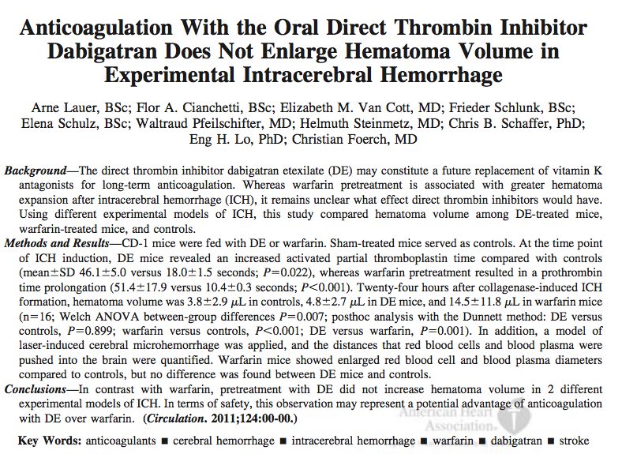

Slide 58
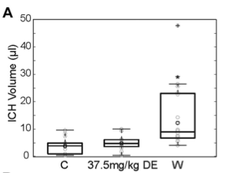
Dabigatran biochemistry
Compared to warfarin, dabigatran-treated mice fared better with induced ICH
Potential reasons:
DTI do not inhibit thrombin-activatable fibrinolysis inhibitor generation whereas drugs that target factor Xa (warfarin) do.
  Dabigatran is a uni-(not bi)valent binder to thrombin. This allows for Dabig-mediated decreases in Factor II activity and sufficient clotting in ICH
Microhemorrhages induced in warfarin-treated mice more often expand toward having increased RBC and blood plasma diameters whereas microbleeds in DE mice do not differ from controls. Thus, we may speculate that in the RE-LY trial, the absolute number of cerebral micobleeds was similar in the warfarin and the dabigatran groups but that microhemorrhages under warfarin more often expanded to- ward symptomatic ICH.

Slide 59
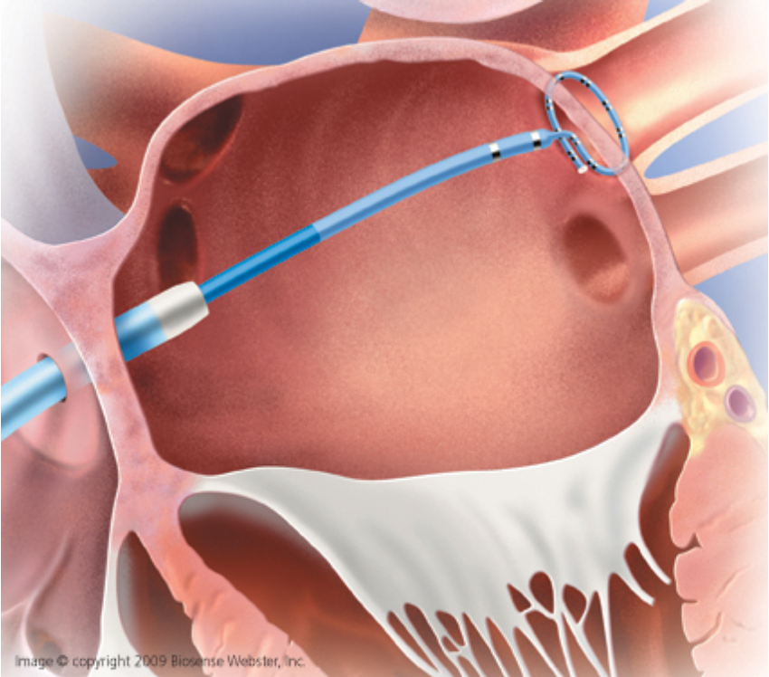
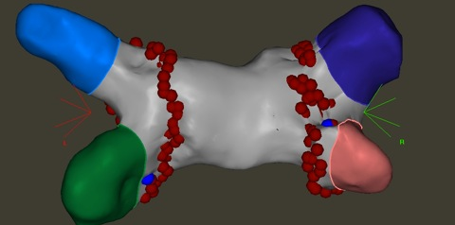
AF Ablation:
Could AF-ablation Reduce Stroke Rates?

Slide 60
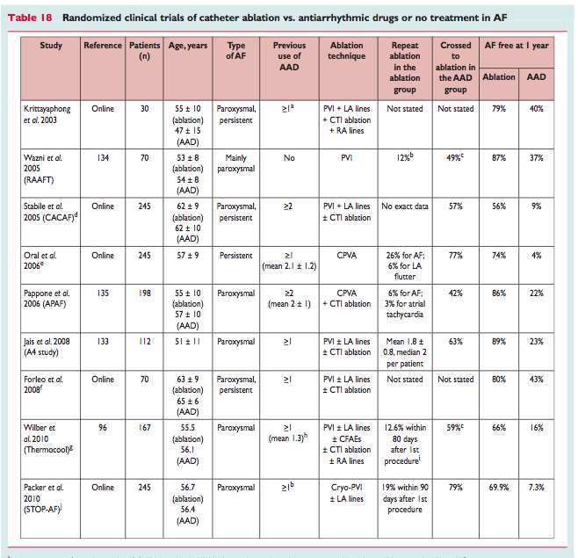

Slide 61
AF ablation
Advantages
Cons:
Proven superior to AAD in maintenance of SR
  Ultimate success rates: 90%
Proven superior to AAD in QOL
Safe
  Two-three hours
  One –day hospital stay
  Often off drugs in follow-up
No data yet on outcomes
  Stroke?
  Mortality?
Success often requires two procedures
Some complications are serious
Requires general anesthesia
Though smaller, the procedure is not “Mickey Mouse.”
LA contractility and asymptomatic MRI lesions still a concern
What about outcomes?

Slide 62
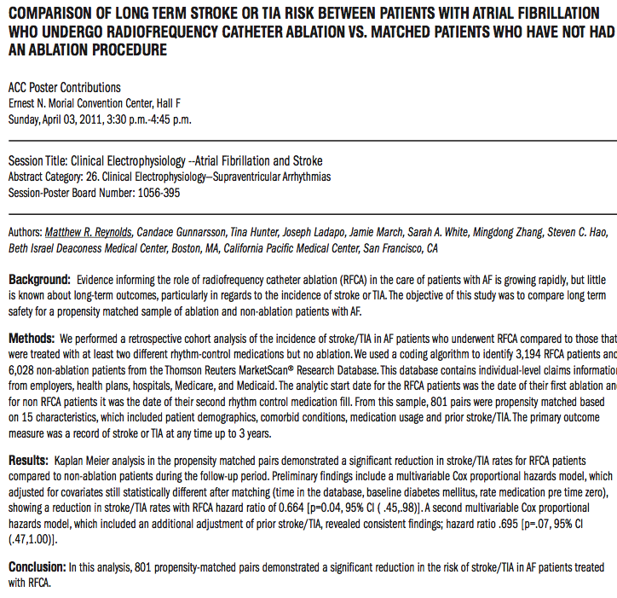

Slide 63
CABANA Trial
CABANA: Catheter Ablation versus Antiarrhythmic Drug Therapy for Atrial Fibrillation
RCT looking at Outcomes:
  Stroke
  Mortality
  Efficacy
  QOL
124 Centers
  Enrolled 492; Target 3000
  Enrollment is problem b/c referred patients want cure—not meds

Slide 64
Most promising in near future…

Slide 65
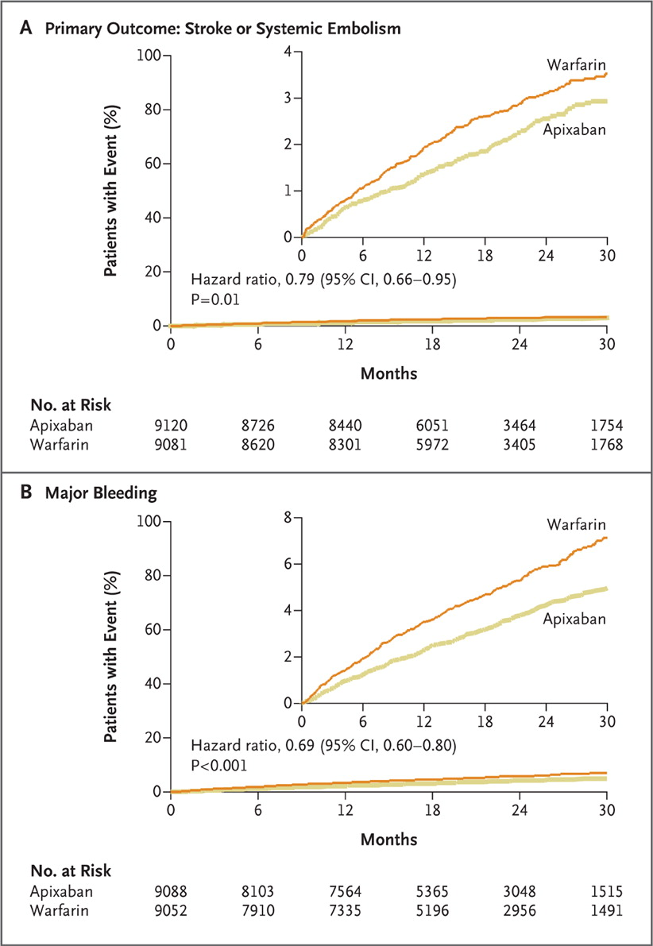
ARISTOTLE Trial: Apixaban
RCT of 18,000 AF patients
Apixaban versus warfarin
Apixaban clearly superior:
  Marked reduction in stroke
  fewer bleeds,
  far-fewer ICH
  Statistically sig decrease mortality
Apixaban not yet FDA-approved

Slide 66
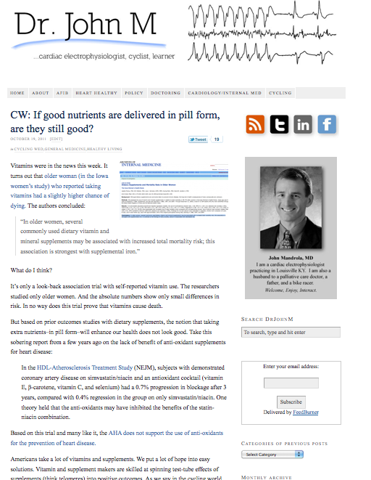
Thanks…
For more real world information on AF and heart rhythm disorders, visit
my blog:
www.drjohnm.org

Slide 67
Granger CB et al. N Engl J Med 2011;365:981-992.
Notes:
Figure 1. Kaplan–Meier Curves for the Primary Efficacy and Safety Outcomes. The primary efficacy outcome (Panel A) was stroke or systemic embolism. The primary safety outcome (Panel B) was major bleeding, as defined according to the criteria of the International Society on Thrombosis and Haemostasis. The inset in each panel shows the same data on an enlarged segment of the y axis.

Slide 68
Where possible, patients at intermediate risk should be considered for oral anticoagulation rather than aspirin, since undertreatment is more harmful than overtreatment.^{28,29} Full discussion with the patient with one combination risk factor would enable agreement to use oral anticoagulation instead of aspirin to allow greater protection against ischemic stroke, especially if these patients value stroke prevention much more than the (theoretical) lower risk of hemorrhage with aspirin and the inconvenience of anticoagulation monitoring.¹⁰ As mentioned, the BAFTA trial found no difference in major bleeding between warfarin (INR 2-3) and aspirin 75 mg in an elderly AF population in primary care,² and aspirin cannot be regarded as a much safer alternative to VKA.

Slide 69
Topics for Today
The increasing burden of AF
New ways to prevent stroke
  Which AF patients should be anticoagulated?
  Which drug?
New recommendations to prevent heart failure
What is the role of AF ablation?
  How has the procedure changed?
  Is the treasure worth the taking the journey?

Slide 70
My tired lines to AF patients…
“Welcome to the club. I am sorry. I am a member too.”
“You have company: “3 million Americans and more than 5 million Europeans also have AF.”
“AF isn’t terrible, but it may require us to be friends.”
“Worrying about AF is like worrying about getting gray hairs, wrinkles or needing reading glasses.”
“AF can be rough, but it isn’t life-threatening. We must never make AF treatment worse than AF.”

Slide 71
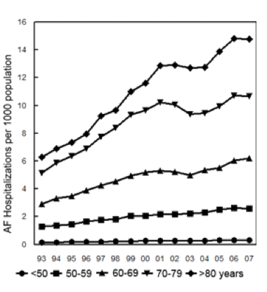
Is the increasing prevalence of AF related to just age?

